Slide 1

Enhanced Preprocessing Techniques for Deep Learning in Pathology Image Analysis
Done by :
Rayyan Ahmad Zuhair Al-Haj – 2017741
Mohammed Wael Adnan – 2018383
Raghad Mahmoud Ahmad AlMoqayad – 2019008

Slide 2
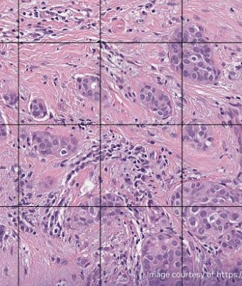
Introduction
Challenges in pathology imaging :
Variability in Staining: Different staining procedures can result in significant variability in color and intensity, making it difficult to consistently identify tissue areas.
Image Quality and Artifacts: Issues like poor image quality, presence of artifacts, and faint colors in some samples can hinder accurate segmentation.
Complex Tissue Structures: The inherent complexity and diversity of tissue structures require sophisticated algorithms to accurately delineate them.
Large Image Sizes: WSIs are typically very large, posing computational challenges in processing them efficiently without losing critical details.

Slide 3
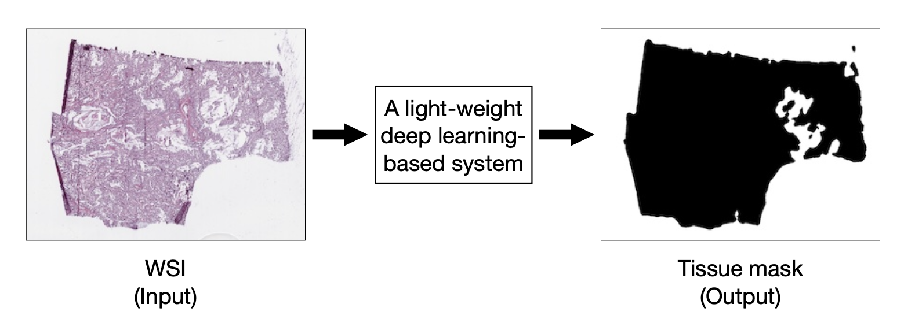
Objective
To develop a lightweight deep learning system for detecting tissue areas in pathology slides, particularly whole slide images (WSIs) of various tissues and stains. This system is aimed to be efficient enough for deployment on commercial micro-controllers in digital slide scanners or for integration into machine learning pipelines, enhancing the accuracy and efficiency of slide scanning and dataset preparation in pathology.

Slide 4

Literature review
Riasatian et al. - In their work on U-Net topologies, Riasatian et al. investigate various architectures for tissue segmentation in WSIs, addressing the challenge of distinguishing tissue regions amidst diverse color variations and artifacts.
Faghani et al. - Faghani and colleagues develop an algorithm for WSI size reduction, focusing on efficiently managing WSIs by discarding unneeded background, thus facilitating more efficient WSI storage and analysis.
Yang et al. - Yang and team emphasize the importance of data preparation for AI in pathology. They discuss steps like slide acquisition, data cleaning, and annotation, highlighting the need for high-quality data in AI applications.
Kim, Yoon, Thakur, Hwang, Lee, Kim, and Chong - Their study introduces a novel segmentation approach for WSIs in colorectal cancer using PCA and DWT in a compressed domain, aiming to enhance diagnostic accuracy and information retention.

Slide 5
Methodologies
1- Data preparation
2- Stain normalization
3- Image quality Enhancement
4- Efficiency and Scalability

Slide 6
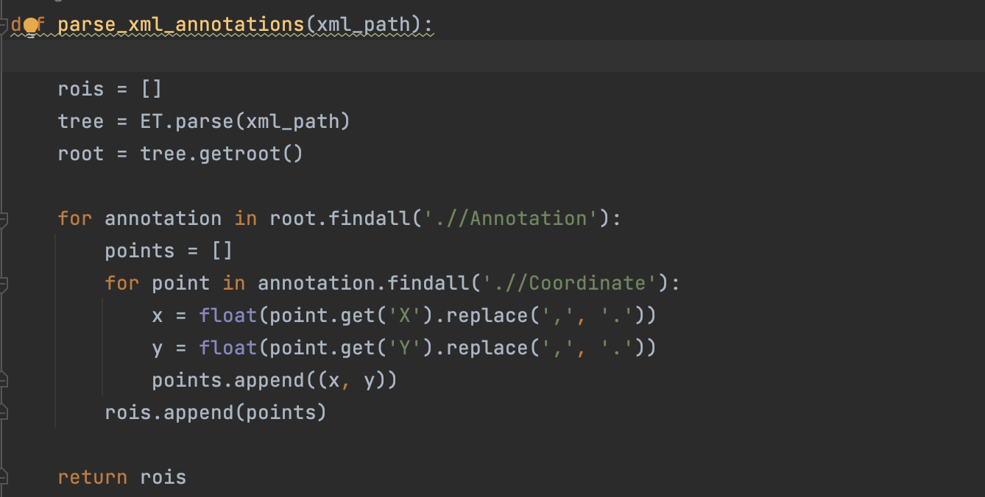
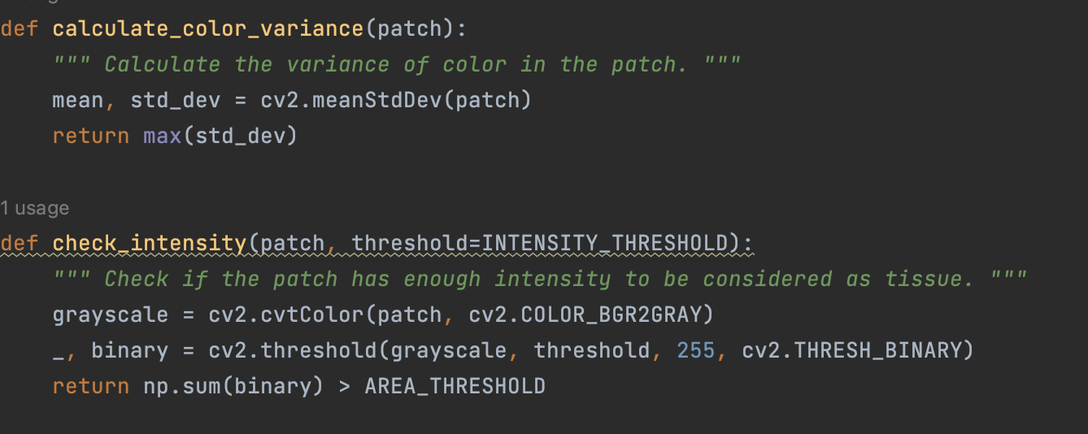
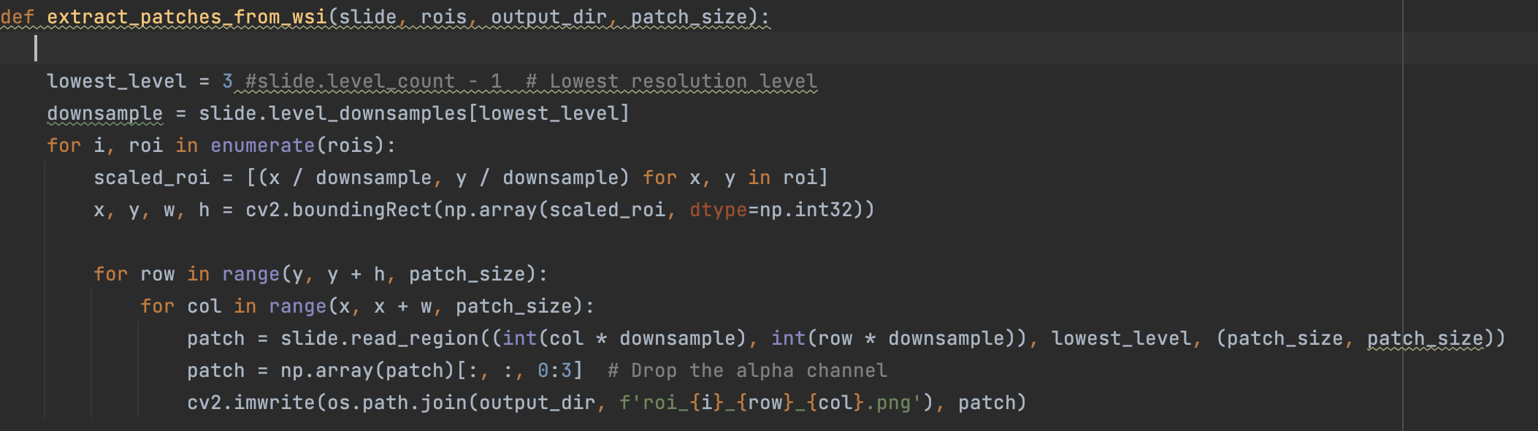
Data Preparation
These functions represent the core logic for determining the quality of each patch. They evaluate whether a patch is predominantly background or has sufficient tissue content, which is critical for ensuring that the deep learning model is trained on relevant data.
These functions illustrate the process of extracting tissue patches from WSIs. The parse_xml_annotations function shows how the code handles XML files to identify ROIs, while extract_patches_from_wsi demonstrates the extraction of these regions, crucial for creating a focused dataset for model training.

Slide 7
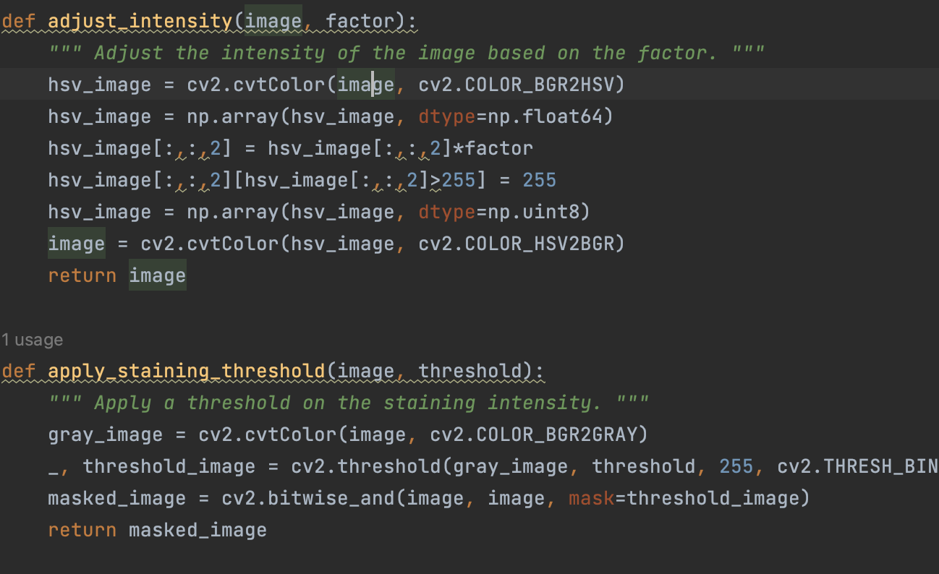
Stain Normalization
This section shows the initial step in stain normalization, which is crucial for setting a consistent staining benchmark for the entire dataset
adjust_intensity:
This function modifies the intensity (brightness) of an image. It converts the image to the HSV (Hue, Saturation, Value) color space and adjusts the V (Value) channel based on a specified factor. This adjustment can either increase or decrease the image's brightness, enhancing visual clarity for better tissue recognition in pathology images.
apply_staining_threshold:
This function applies a threshold to focus on areas with significant staining intensity. It converts the image to grayscale, then uses a binary threshold to isolate regions with staining intensity above a set threshold value. This step is vital for emphasizing crucial staining features and reducing the impact of less relevant or background areas in the image.

Slide 8
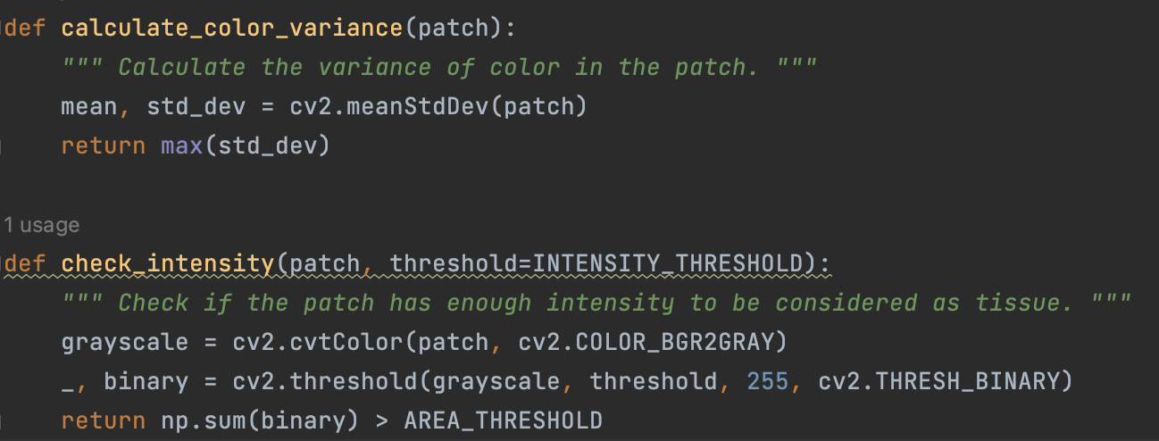
Image Quality Enhancement
Like the data preparation, These functions are central to evaluating the quality of each image patch. calculate_color_variance assesses the variance in color within a patch to identify significant changes, while check_intensity checks if the patch's intensity is sufficient to consider it as tissue. These checks ensure that only high-quality patches with meaningful tissue content are used for analysis.
This function combines the results of color variance and intensity checks to determine if a patch is likely to contain relevant tissue. It is a crucial step in filtering out non-tissue areas or low-quality patches from the dataset.

Slide 9
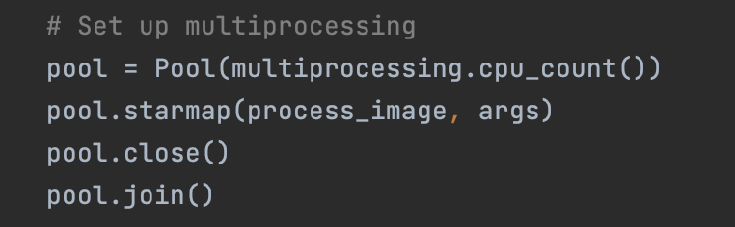
Efficiency & Scalability
This code snippet shows how Python's multiprocessing is used to parallelize the stain normalization process. The use of Pool with multiprocessing.cpu_count() optimizes the processing by using all available CPU cores, enhancing efficiency.
Also, This demonstrates the application of parallel processing to the extended stain normalization tasks, including intensity adjustment and staining threshold application, ensuring the pipeline processes large batches of images swiftly.

Slide 10
Results
Despite significant progress in developing advanced image preprocessing techniques, our project could not proceed to the model training phase due to limited time and a lack of continuous expert guidance. Had the project been completed, we would have been able to train a deep learning model on these optimally preprocessed images, potentially leading to groundbreaking improvements in pathology image analysis. This might have included more accurate disease identification, quicker diagnostics, and a substantial contribution to the field of digital pathology.

Slide 11
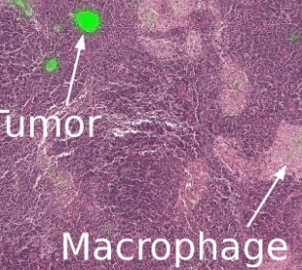
Conclusion
This project, though not fully realized, underscores the potential impact and importance of deep learning in medical diagnostics and opens avenues for future research and development in this vital field.

Slide 12
Resources
Kim, H., Yoon, H., Thakur, N., Hwang, G., Lee, E. J., Kim, C., & Chong, Y. (2021). Deep learning-based histopathological segmentation for whole slide images of colorectal cancer in a compressed domain.
Faghani, S., Codipilly, D.C., Moassefi, M., Iyer, P.G., & Erickson, B.J. (2023). Optimizing Storage and Computational Efficiency: An Efficient Algorithm for Whole Slide Image Size Reduction.
Riasatian, A., Rasoolijaberi, M., Babaei, M., & Tizhoosh, H.R. (2020). A Comparative Study of U-Net Topologies for Background Removal in Histopathology Images.
Alexander Selvikvåg Lundervold, Arvid Lundervold. (2019). An overview of deep learning in medical imaging focusing on MRI.
Mustafa Umit Oner, Mei Ying Ng,Danilo Medina Giro. (2022). An AI-assisted tool for efficient prostate cancerdiagnosis in low-grade and low-volume cases.
Liron Pantanowitz, Gabriela M Quiroga-Garza, Lilach Bien, Ronen Heled, Daphna Laifenfeld, Chaim Linhart, Judith Sandbank. (2020) . An artificial intelligence algorithm for prostate cancer diagnosis in whole slide images of core needle biopsies: a blinded clinical validation and deployment study

Slide 13


